Slide 1
Chapter 2
Database System Concepts and Architecture

Slide 2
Data Representation
Data is actually stored as bits, but it is difficult to work with data at this level.
It is convenient to view data at higher levels of abstraction.
Data models provide different ways to view data.

Slide 3

Entity Relationship Model
Part of a UNIVERSITY
Entities:
FACULTY
COURSE
STUDENT
DEPARTMENT:
F#, FNAME
C#, SNAME
S#, CNAME,
D#, DNAME

Slide 4

Example of a Database
Relationships:
STUDENT takes COURSE
COURSE has prerequisite COURSE
FACULTY teach COURSE
COURSE offered by DEPARTMENT
STUDENT majors in DEPARTMENT
DEPARTMENT
FACULTY
majors
Offers
teaches
takes
STUDENT
COURSE
prerequisite

Slide 5
Hierarchical model
The data is organized into a tree-like structure using records and links
Navigational and procedural operations

Slide 6
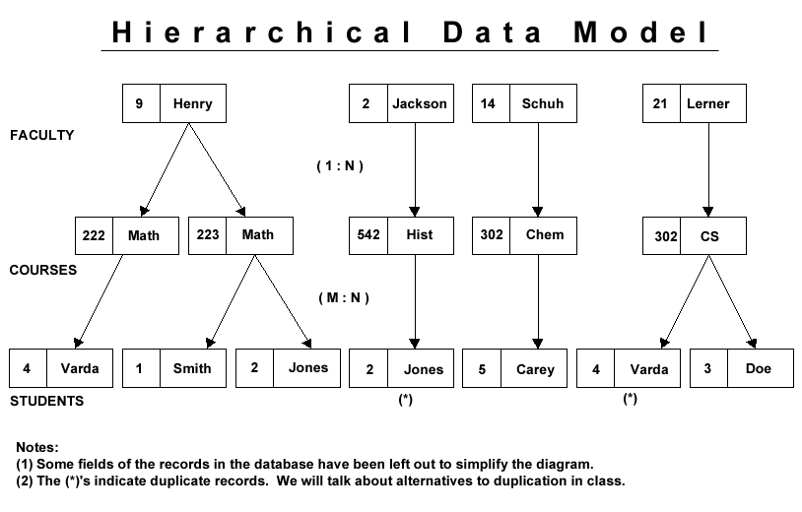
records
pointers
records
pointers

Slide 7
Network model
The data is organized into a network structure using records and links
Navigational and procedural operations

Slide 8
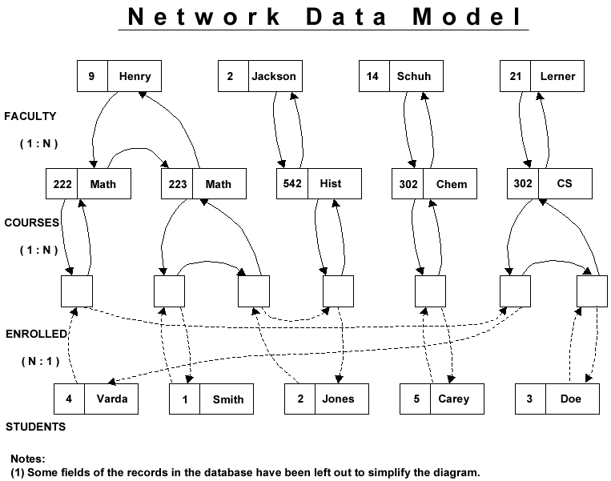
records
pointers
records
pointers
records
pointers
records

Slide 9
Relational model
all data is represented in terms of tuples (records), grouped into relations (files)
declarative operations used to specify what to get instead of how to get

Slide 10
Relational Model
FACULTY
F# | FNAME
2 | Jackson
9 | Henry
14 | Schuh
21 | Lerner
COURSES
C# | CNAME
222 | Math
223 | Math
302 | CS
302 | Chem
542 | Hist
STUDENT
S# | SNAME
1 | Smith
2 | Jones
3 | Doe
4 | Varda
5 | Carey
all data is represented in terms of tuples (records), grouped into relations (files)
FC
F# | C#
2 | 542
9 | 222
9 | 223
14 | 302
21 | 304
SC
S# | C#
1 | 223
2 | 223
2 | 542
3 | 304
4 | 222
4 | 304
5 | 302

Slide 11
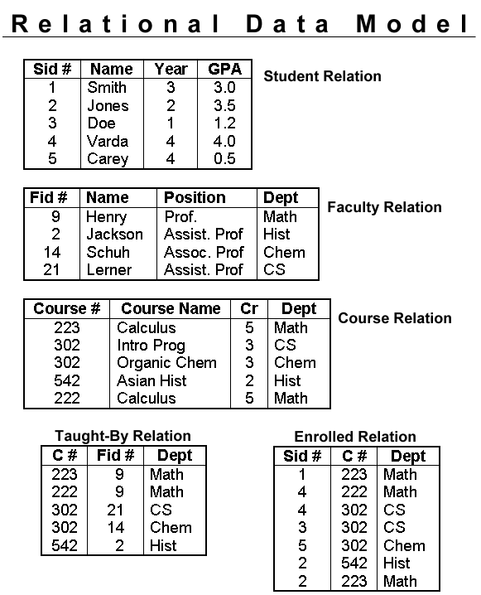
Relational Model

Slide 12
Data Models
A data model specifies how data is structured and operated.
It consists of three parts:
a set of concepts to describe the structure of a database
a set of operations for manipulating these structures
a set of constraints that the database should obey.

Slide 13
Data Models
Data Model Concepts
describe the structure of a database
Constructs are used to define the database structure
elements and their data types (e.g. name, age, address)
groups of elements (e.g. entity, record, table)
relationships among such groups

Slide 14
Data Models
Data Model Operations:
specify database retrievals and updates by referring to the constructs of the data model.
Operations on the data model may include
basic model operations
(generic insert, delete, update, query)
user-defined operations
(e.g. compute_student_gpa, update_inventory)

Slide 15
Data Models
Data Model Constraints:
specify some restrictions on valid data; these constraints must be enforced at all times
Examples
Every entity must have a unique identity
Entities referenced must exists

Slide 16


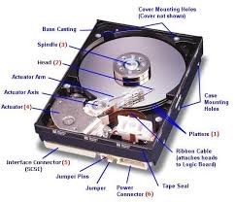
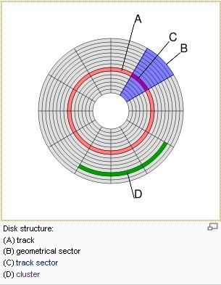
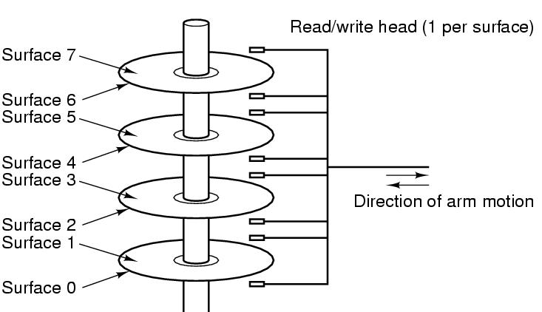
Categories of Data Models

Slide 17
Physical Data Models
Physical (Low-level) data models:
Provide concepts that describe details of how data is stored on the computer: tracks, cylinders, indices

Slide 18
Conceptual Data Models
Conceptual (high-level, semantic) data models:
Provide concepts that are close to the way many users perceive data.
( entity-based or object-based data models.)

Slide 19
Implementation Data Models
Implementation data models:
Provide concepts that fall between the conceptual and physical data models, used by many commercial DBMS implementations
(Hierarchical, Network, Relational data models).

Slide 20
Categories of Data Models
Common Features of all three kinds of data models
Separate the meta data (description of data) from the data in the database.

Slide 21
Categories of Data Models
Physical (Low-level) data models:
Provide concepts that describe details of how data is stored in the computer: tracks, cylinders, indices
Conceptual (high-level, semantic) data models:
Provide concepts that are close to the way many users perceive data.
( entity-based or object-based data models.)
Implementation data models:
Provide concepts that fall between the above two, used by many commercial DBMS implementations
(Hierarchical, Network, Relational data models).
Self-Describing Data Models:
Combine the description of data with the data values. Examples include XML, NOSQL stores.

Slide 22
Database Schema
Database Schema:
The description of data.
Elements
Data types,
Constraints on the database.
Schema Diagram:
An illustrative display of (most aspects of) a database schema.
Student
S# | SNAME | AGE
Course
C# | CNAME | LOC
Grade
S# | C# | MARK

Slide 23
Database Instances
Database Instance (state, occurrence, or snapshot)
The actual data stored in a database at a particular moment in time. This includes the collection of all the data in the database.
Student |  |  |  | Grade |  |  |  | Course
S# | SNAME | AGE |  | S# | C# | MARK |  | C# | CNAME | LOC
1000 | John | 25 |  | 1000 | CS300 | 90 |  | CS300 | OS | ME300
2000 | Kate | 24 |  | 1000 | CS305 | 85 |  | CS305 | DB | UC231
3000 | Tony | 20 |  | 2000 | CS300 | 85 |  | MT230 | AL | TB300

Slide 24
Database instances
Student |  |  |  | Grade |  |  |  | Course
S# | SNAME | AGE |  | S# | C# | MARK |  | C# | CNAME | LOC
1000 | John | 25 |  | 1000 | CS300 | 90 |  | CS300 | OS | ME300
2000 | Kate | 24 |  | 1000 | CS305 | 85 |  | CS305 | DB | UC231
3000 | Tony | 20 |  | 2000 | CS300 | 85 |  | MT230 | AL | TB300
Initial Database State:
database state when it is initially loaded into the system.
Valid State:
A state that satisfies the structure and constraints of the database.

Slide 25
Database Schema vs. Database Instance
Distinction
The database schema changes very infrequently.
The database instance changes every time the database is updated.
Schema is also called intension.
Instance is also called extension.

Slide 26
Database Schema
Database Schema
Description of data at some abstraction level.
Each level has its own schema.
There are three levels of schemas:
physical,
conceptual,
external.

Slide 27

Three-Schema Architecture
Application programs
payroll
billing
records
View 1
View 2
View 3
External
Schemas
External/Conceptual
mapping
Conceptual schema
Conceptual/Internal
mapping
Internal schema
Database

Slide 28
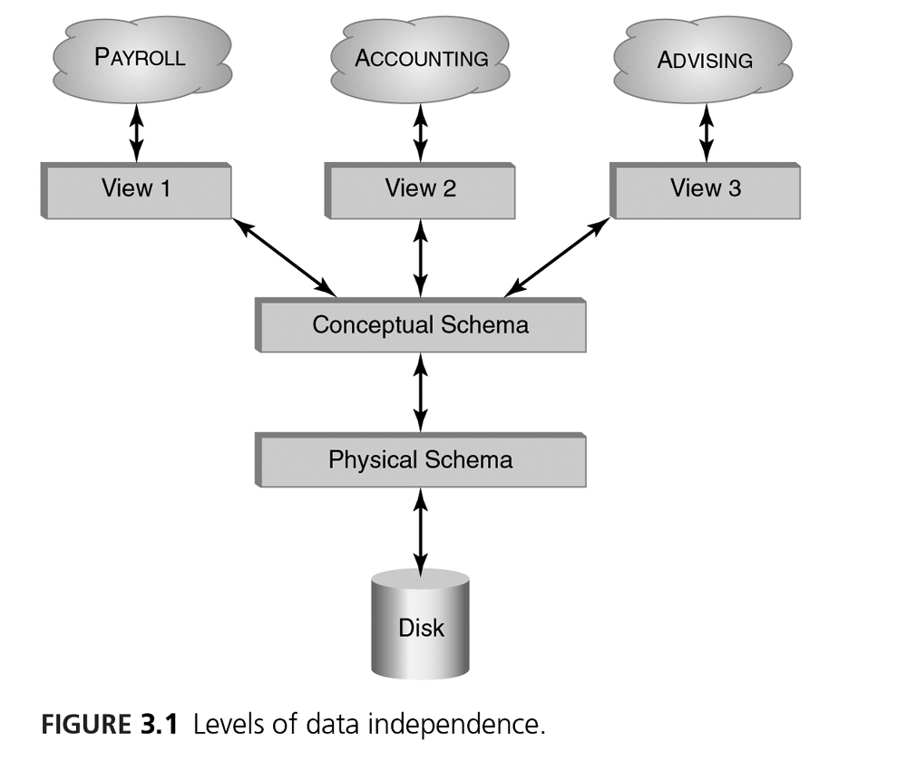
Three-Schema Architecture

Slide 29
Three-Schema Architecture
Internal schema at the internal level
Describe physical storage structures and access paths (e.g indexes).
Typically uses a low-level data model.
Internal schema
Database

Slide 30
Three-Schema Architecture
Conceptual schema at the conceptual level
Describe the structure and constraints for the whole database.
Uses a high-level or an implementation data model.
Conceptual schema
Internal schema
Database

Slide 31
Three-Schema Architecture
Application programs
payroll
billing
records
External
Schemas
View 1
External
Schemas
View 1
View 2
View 2
View 3
View 3
Conceptual schema
External schemas at the external level
Describe the various user views.
Usually uses the same data model as the conceptual schema

Slide 32
Three-Schema Architecture
Application programs
payroll
billing
records
External
Schemas
View 1
External
Schemas
View 1
View 1
View 2
View 2
View 2
View 3
View 3
View 3
Conceptual schema
Application programs refer to an external schema, and are mapped by the DBMS to the internal schema for execution.

Slide 33
Three-Schema Architecture
Advantages:
multiple views of the same data
Program-data independence.
View 1
View 2
View 3
External
Schemas
External/Conceptual
mapping
Conceptual schema
Conceptual/Internal
mapping
Internal schema
Database

Slide 34
Logical Data Independence
The capacity to change the conceptual schema without having to change the external schemas and their associated application programs.
View 1
View 2
View 3
External
Schemas
External/Conceptual
mapping
Conceptual schema
Conceptual/Internal
mapping
Internal schema
Database

Slide 35
Physical Data Independence
The capacity to change the internal schema without having to change the conceptual schema.
The internal schema may be changed when certain file structures are reorganized or new indexes are created to improve database performance
View 1
View 2
View 3
External
Schemas
External/Conceptual
mapping
Conceptual schema
Conceptual/Internal
mapping
Internal schema
Database

Slide 36
Data Independence (continued)
When a schema at a lower level is changed
Only the mappings between this schema and higher-level schemas need to be changed
View 1
View 2
View 3
External
Schemas
External/Conceptual
mapping
Conceptual schema
Conceptual/Internal
mapping
Internal schema
Database

Slide 37
Data Independence (continued)
The higher-level schemas themselves are unchanged.
Hence, the application programs need not be changed since they refer to the external schemas.
View 1
View 2
View 3
External
Schemas
External/Conceptual
mapping
Conceptual schema
Conceptual/Internal
mapping
Internal schema
Database

Slide 38
DBMS
Centralized DBMS
Client-Server DBMS

Slide 39
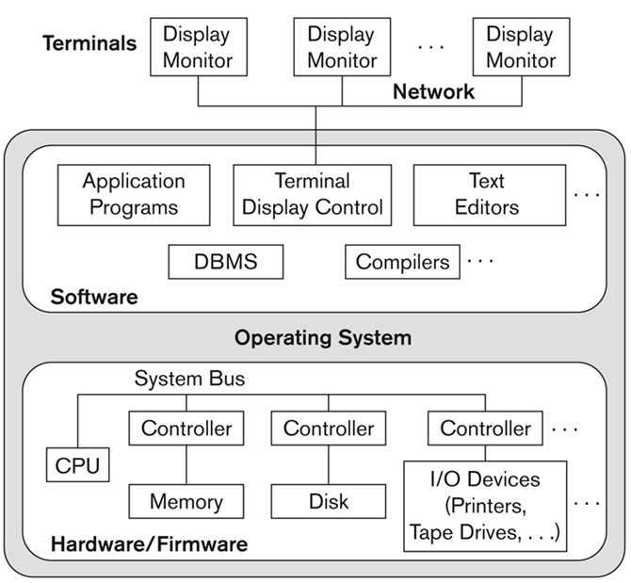
Physical Centralized Architecture

Slide 40
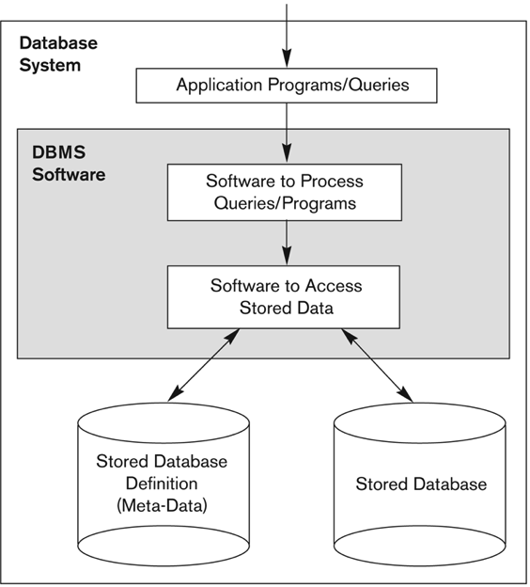
Centralized DBMS
Combines everything into single system
DBMS software
Hardware
Application programs
User interface processing software.
User can still connect through a remote terminal but all processing is done at a centralized site.

Slide 41
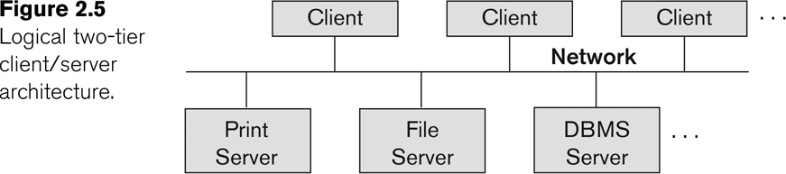
Basic Two Tier Client-Server Architectures
Specialized Servers with Specialized functions
Print server
File server
DBMS server
Web server
Email server
Clients can access the specialized servers as needed

Slide 42
Client-Server Architecture
Application
Program
Client
SQL
DBMS
Server
DB

Slide 43
Logical Two-Tier Architecture
Client
Client
SQL
Network
SQL
DBMS
Server

Slide 44
Clients
Use client software module to access and utilize the various server resources.
Kinds of client machine
diskless machines
PCs
Workstations with disks with only the client software installed.
Connected to the servers via some form of a network.
(LAN: local area network, wireless network, etc.)

Slide 45
DBMS Server
Provides database query and transaction services to the clients
Relational DBMS servers are often called SQL servers, query servers, or transaction servers
Applications running on clients utilize an Application Program Interface (API) to access server databases via standard interface :
ODBC: Open Database Connectivity standard
JDBC: for Java programming access
Client and server must install appropriate client module and server module software for ODBC or JDBC

Slide 46
Two Tier Client-Server Architecture
Client and server must install appropriate client module and server module software for ODBC or JDBC
A client program may connect to several DBMSs, sometimes called the data sources.
In general, data sources can be files or other non-DBMS software that manages data.
Client
Client
Network
DBMS
Server

Slide 47
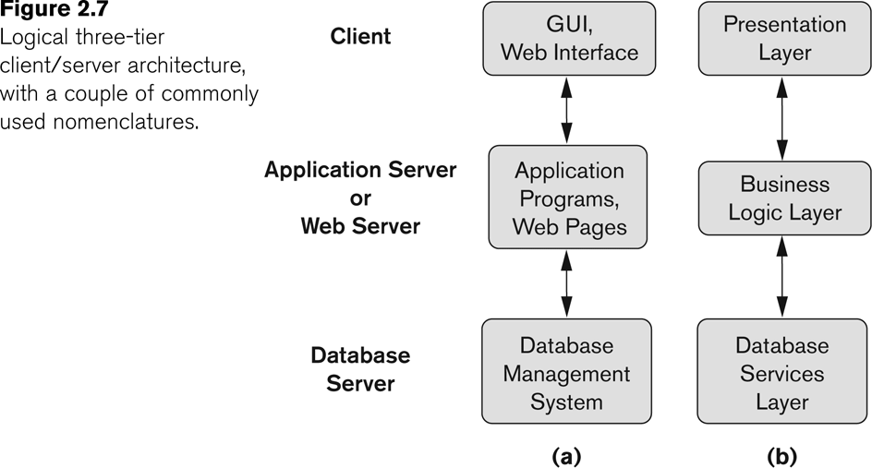
Three-Tier Client-Server architecture

Slide 48
Three Tier Client-Server Architecture
Common for Web applications
Intermediate Layer called Application Server or Web Server:
Stores the web connectivity software and the business logic part of the application used to access the corresponding data from the database server
Acts like a conduit for sending partially processed data between the database server and the client.
Three-tier Architecture Can Enhance Security:
Database server only accessible via middle tier
Clients cannot directly access database server

Slide 49
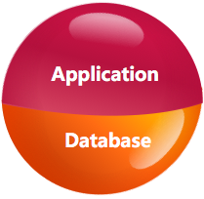
Database Users
Actors behind the Scene
Those who design and develop the DBMS software and related tools, and the computer systems operators
Actors on the Scene
Those who actually use and control the database content, and those who design, develop and maintain database applications

Slide 50
Actors behind the Scene
System Designers and Implementers
Tool Developers
Operators and Maintenance Personnel

Slide 51
Database Users – Actors behind the Scene
System Designers and Implementers: Design and implement DBMS packages in the form of modules and interfaces and test and debug them. The DBMS must interface with applications, language compilers, operating system components, etc.
Tool Developers: Design and implement software systems called tools for modeling and designing databases, performance monitoring, prototyping, test data generation, user interface creation, simulation etc. that facilitate building of applications and allow using database effectively.
Operators and Maintenance Personnel: They manage the actual running and maintenance of the database system hardware and software environment.

Slide 52
Actors on the Scene
Database administrators (DBA)
Database Designers:
System Analysts and Application Developers
End-users

Slide 53
Database Users – Actors on the Scene
Database administrators:
Responsible for acquiring software and hardware resources, controlling its use and monitoring efficiency of operations and authorizing access to the database, for coordinating and monitoring its use,
Database Designers:
Responsible to defining the content, the structure, the constraints, and functions or transactions against the database. They must communicate with the end-users and understand their needs.

Slide 54
Database Users – Actors on the Scene
System Analysts and Application Developers
This category currently accounts for a very large proportion of the IT work force.
System Analysts: They understand the user requirements of end users and sophisticated users and design applications including canned transactions to meet those requirements.
Application Programmers: Implement the specifications developed by analysts and test and debug them before deployment.

Slide 55
Database Users
End-users:
Use the database in day to day basis
bank-tellers or airline reservation clerks who do this activity for an entire shift of operations
Carleton Central users: students, instructors, etc.
Don’t know how the DB is structured
How many tables
How tables are structured and related
End-users can be categorized into:
Naïve users
Business Analysts:

Slide 56
Database End Users
Naïve End Users:
They use previously well-defined functions in the form of “canned transactions” against the database.
Users of Mobile Apps mostly fall in this category
Bank-tellers or reservation clerks are parametric users who do this activity for an entire shift of operations.
Business Analysts:
There is an increasing need for such people who can analyze vast amounts of business data and real-time data (“Big Data”) for better decision making related to planning, advertising, marketing etc.
Many use tools in the form of software packages that work closely with the stored database.

Slide 57
Types of Database Languages
High Level Language:
SQL is a high level relational language
“set”-oriented and specify what data to retrieve rather than how to retrieve it.
called declarative languages.
Low Level Language:
Retrieve data one record-at-a-time;
Constructs such as looping are needed to retrieve multiple records, along with positioning pointers.
called Procedural languages.

Slide 58
Database Languages
Data Definition Language (DDL)
Data Manipulation Language (DML)
Query Language (QL)

Slide 59
Data Definition Language (DDL)
Used by the database designers and DBA to specify the conceptual schema of a database.
In many DBMSs, the DDL is also used to define internal and external schemas (views).
In some DBMSs, additional languages are used
Storage Definition Language (SDL)
define internal schemas
View Definition Language (VDL)
define external schemas.

Slide 60
Data Manipulation Language (DML)
Used to specify insert, delete and update of tuples in the database
Kinds of DML
High-Level or Non-procedural Languages: (SQL)
Low Level or Procedural Languages:
Difference
add area code to the phone number of everyone

Slide 61
How to use DML
May be used in a standalone way
insert into Student
values ('1000', ‘John', 25);
May be embedded in a programming language (host language)
COBOL, C, C++, or Java.
A library of functions can also be provided to access the DBMS from a programming language
exec sql insert into Student
values ('1000', ‘John', 25);

Slide 62
Query Language (QL)
Used to specify database retrievals
How to use QL
May be used in a standalone way
select age from Student where s#=’1000’;
May be embedded in a programming language
COBOL, C, C++, or Java.
A library of functions can also be provided to access the DBMS from a programming language
exec sql select age from Student
where s#=’1000’;

Slide 63
DBMS Programming Language Interfaces
Embedded Approach:
embedded SQL (for C, C++, etc.)
SQLJ (for Java)
Procedure Call Approach:
JDBC for Java
ODBC for other programming languages
Database Programming Language Approach:
ORACLE has PL/SQL, a programming language based on SQL; language incorporates SQL and its data types as integral components
Scripting Languages:
PHP (client-side scripting) and Python (server-side scripting) are used to write database programs.

Slide 64
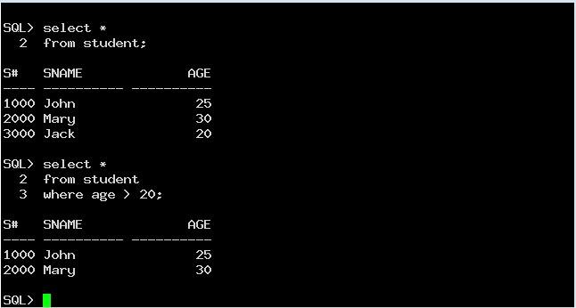
Stand-alone query language interfaces
SQL*Plus in ORACLE
Entering SQL commands
Notes:
Show sqlplus

Slide 65
User-Friendly DBMS Interfaces
Menu-based, popular for browsing on the web
Forms-based, designed for naïve users
Graphics-based
(Point and Click, Drag and Drop, etc.)
Natural language: requests in written English
Combinations of the above:
For example, both menus and forms used extensively in Web database interfaces

Slide 66
Other DBMS Interfaces
Speech as Input and Output
Web Browser as an interface
Parametric interfaces, e.g., bank tellers using function keys.
Interfaces for the DBA:
Creating user accounts, granting authorizations
Setting system parameters
Changing schemas or access paths

Slide 67
Database System Utilities
To perform certain functions such as:
Loading data stored in files into a database. Includes data conversion tools.
Backing up the database periodically on tape.
Reorganizing database file structures.
Performance monitoring utilities.
Report generation utilities.
Other functions, such as sorting, user monitoring, data compression, etc.

Slide 68
Other Tools
Data dictionary / repository:
Used to store schema descriptions and other information such as design decisions, application program descriptions, user information, usage standards, etc.
Active data dictionary is accessed by DBMS software and users/DBA.
Passive data dictionary is accessed by users/DBA only.

Slide 69
Other Tools
Application Development Environments and CASE (computer-aided software engineering) tools:
Examples:
PowerBuilder (Sybase)
JBuilder (Borland)
JDeveloper 10G (Oracle)

